Slide 1

Stock Prediction Using ML Tools
Harnessing the Power of Social Media
Tori Davis, Dominic Lim, Ria Mahajan, Javier Rondon
Notes:
Transition after “Just to kick us off”

Slide 2
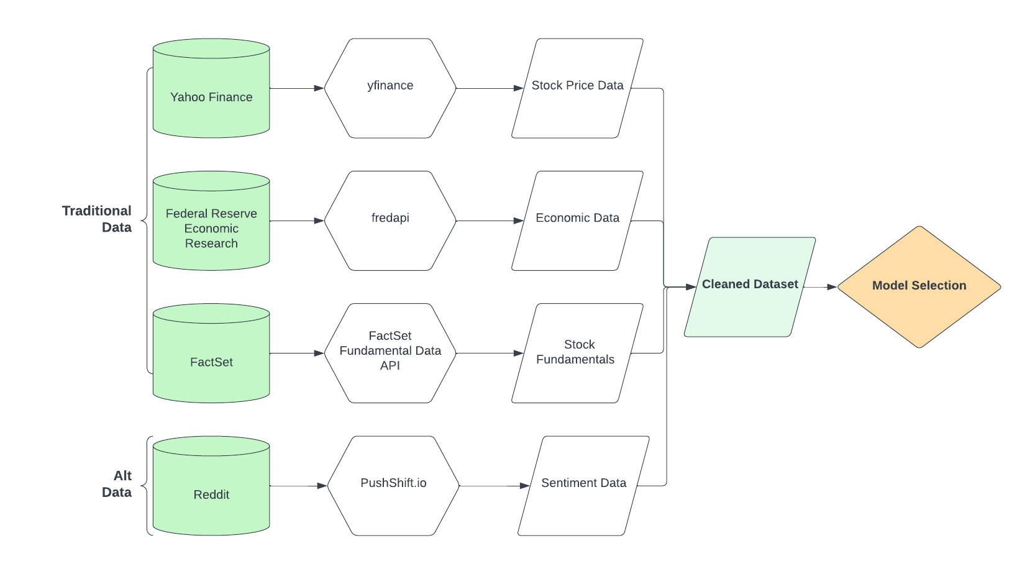
Introduction/Problem
Major spike in trading volumes especially during the pandemic
Most investors use “gut-feeling”; select few approach financial advisors
Is there a way to know stock movement so I know what to invest in next?
By using publicly available market and social media data as input, can sentiment analysis help to predict stock price movements?
Notes:
Transition after “traditional, numeric data and alt,text data
”

Slide 3
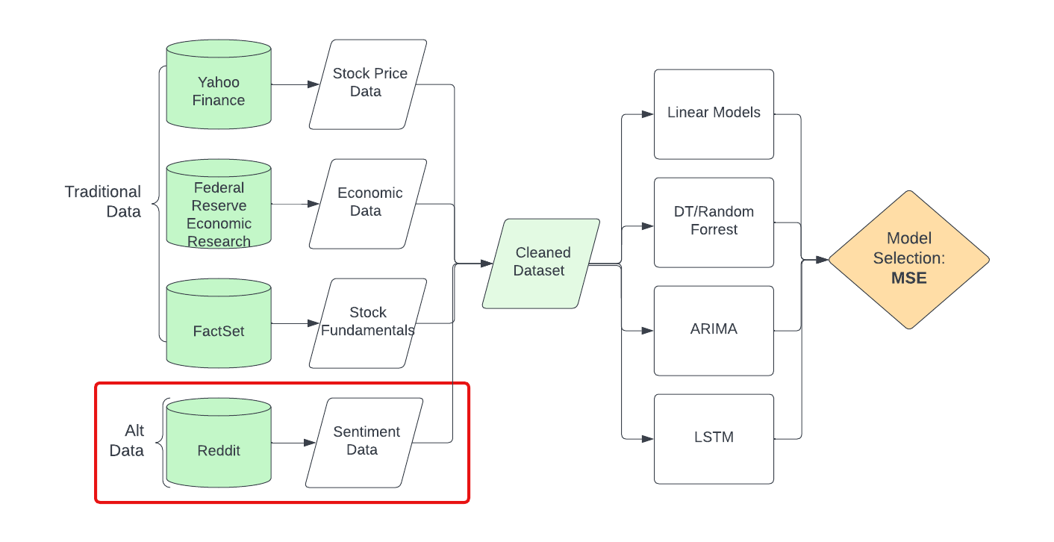
Recap: Next Steps
Finalize Dataset preparation
EDA with all features
Sentiment Analysis
Modelling
Notes:
Transition after “traditional, numeric data and alt,text data
Finalize Dataset preparation
EDA with all features
Sentiment Analysis
Modelling
”

Slide 4
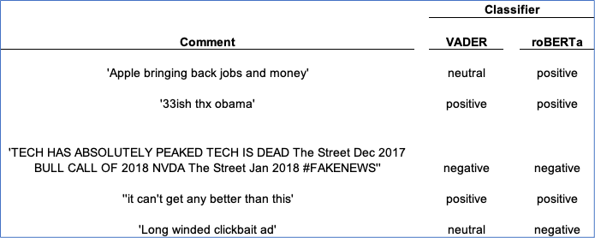
Tools for Sentiment Analysis
Lexicon rules-based VADER
Tuned to sentiments expressed in social media
Acceptable accuracy
Less than 0.5 ms per comment
Pre-trained NLP classifier roBERTa
Model pre-trained with 124 million tweets (2018-2021)
Fine tuned for sentiment analysis
~ 51 ms per comment
We used Vader as a compromise between speed and accuracy
Not enough computing resources to use roBERTa.

Slide 5
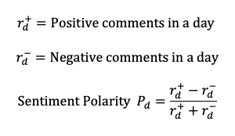
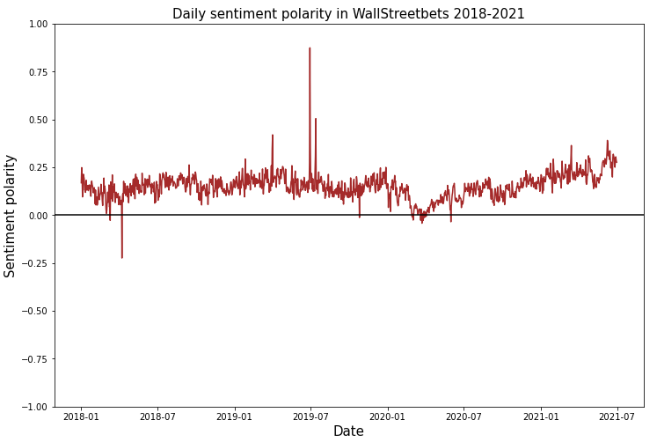
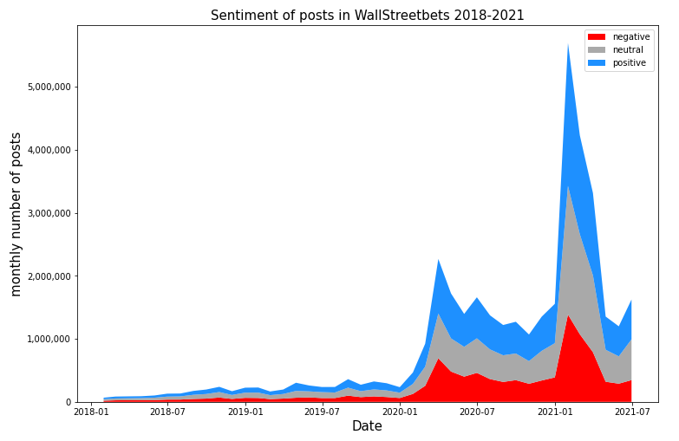
Sentiment r/wallstreetbets

Slide 6
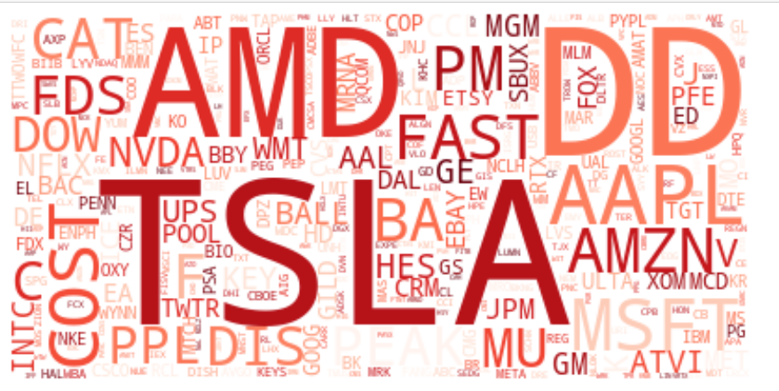
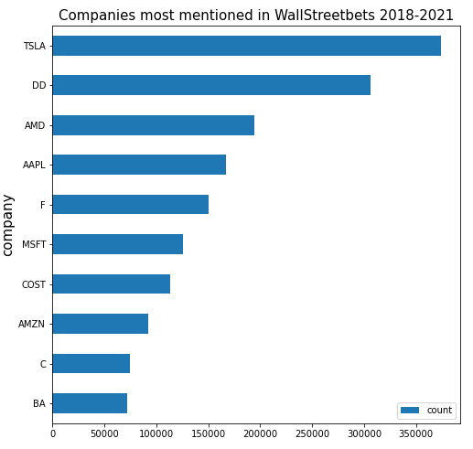
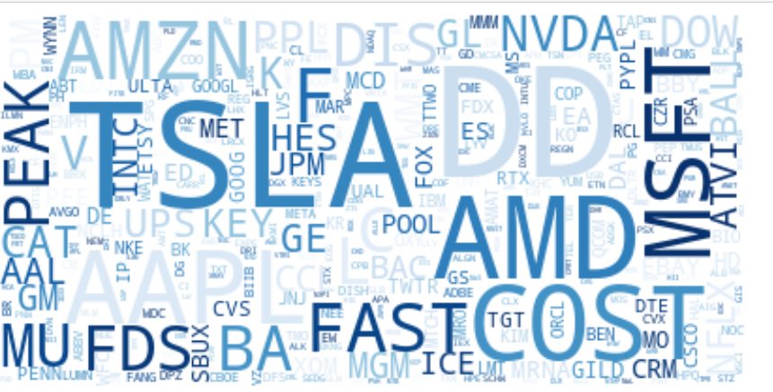
Sentiment in r/wallstreetbets
by stock
Negative mentions
Positive mentions
Notes:
Baseline presentation for Coca-Cola & Pepsi
Reasons for pivoting:
Number of comments were too low
Comments could include “KO” without referencing stock ticker
Needed unique stock tickers because lack of “$”

Slide 7
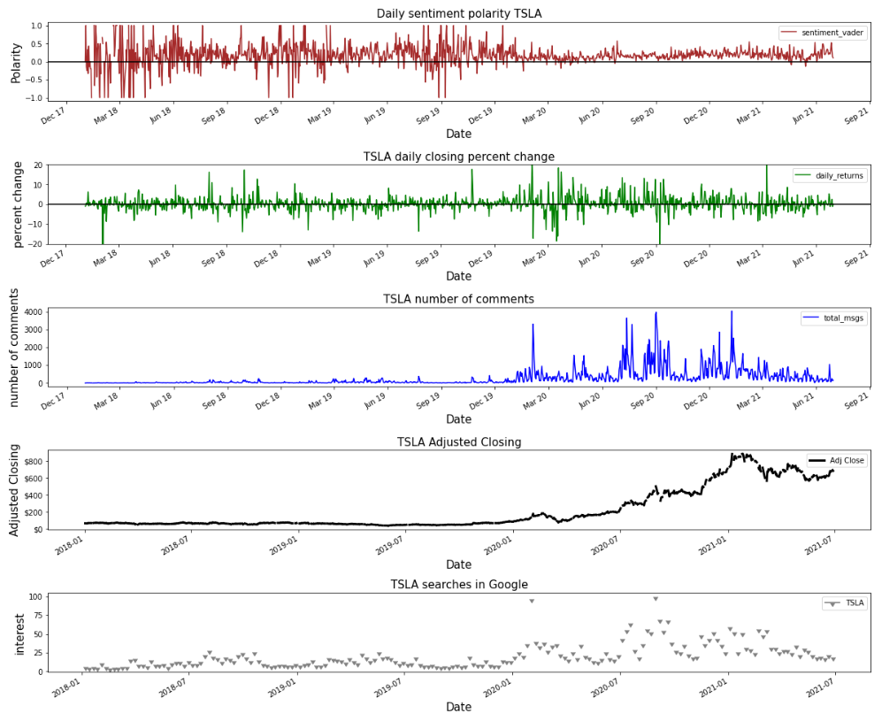
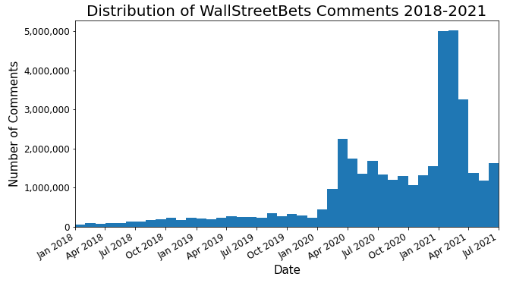
Statistical Analyses
Granger causality test indicated sentiment may be useful in predicting TSLA returns (p =0.03) but not AAPL returns (p = 0.3) after number of comments increased in January 2020

Slide 8
Sentiment Correlation with Milestones
Key dates were identified
Focused on dates with high percent change on returns
Large increase in comments starting in 2020
Possible relation to increased usage of Robinhood app after 2020 covid-influenced stock market crash
Research on major events that occurred on those dates
Stock splits
Increase in sales
Bad press
Overall market movement
Notes:
After determining that the sentiment data could have predicting power, we looked to see if there was any correlation between the dates with high percentage on returns and the reddit comments. There was a large increase in comments in 2020 which could have been caused by the increased usage of Robinhood. This allowed a younger demographic to ease into stock trading. The team focused on this timeframe so that our sample of comments would be sufficient to get a realistic polarity score. Major events that occurred on our key dates ranged from stock splits for both companies, increase in sales, bad press, and overall market movement.

Slide 9
TSLA Sentiment Correlation
Date | Direction Change | Reason
2020-02-03 & 2020-02-04 | ↑ | Stock was overvalued
2020-02-05 | ↓ | Delivery delays
2021-03-09 | ↑ | Increased Tesla sales
2020-05-01 | ↓ | Elon tweeted that stock price is too high
2020-07-06 | ↑ | Good profits
2020-08-12 & 2020-08-31 | ↑ | Stock split announced & went into effect
2020-09-08 | ↓ | Left off S&P 500
2020-09-14 | ↑ | Elon tweeted about “Battery Day”
2020-09-23 | ↓ | Shareholders disappointed with “Battery Day”
Small initial sample size on r/wallstreetbets
Influenced polarity scores compared to post-2020 boom
Focused on dates post-boom
Notes:
Here is a table of the key dates for the Tesla stock that yielded the largest change in returns. The causes vary greatly - from Tesla performance to stock evaluation to tweets from a chaotic CEO.

Slide 10
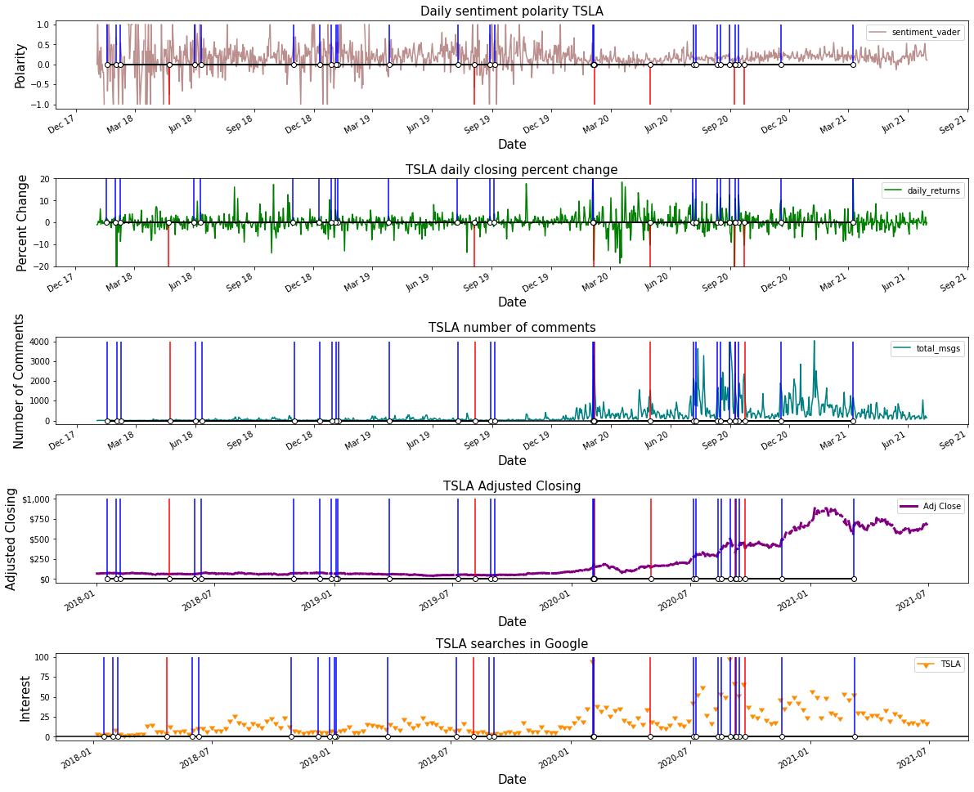
TSLA Milestones
Color | Milestone
Blue | Positive Returns
Red | Negative Returns
Notes:
Here you can see the major milestones overlaid on a few different timeline graphs that Javier presented. The blue lines represent days of large positive change in returns while the negative is red. Key takeaways are that the polarity of the comments neutralized significantly as the number of comments increased. The days of high percent change have a stronger correlation with the number of comments and Google searches than they do with polarity. The closing price also leveled off during the period with the most major milestones.

Slide 11
AAPL Sentiment Correlation
Date | Direction Change | Reason
2019-06-07 | ↑ | Stock was undervalued
2020-03-24 | ↑ | Covid response - support online learning
2020-07-31 | ↑ | Stock split announcement
2020-08-21 | ↑ | Stock split FAQ shared with investors
2020-09-03 | ↓ | Market down
2020-09-08 | ↓ | Tech bubble crashing
2020-10-12 | ↑ | Iphone release
Apple was relatively more stable than Tesla
Decreases were related to larger market
Notes:
Next, we took a look at Apple’s stock. Their stock was more stable than Tesla’s. Days of large decreases in returns trended with the rest of the tech bubble, rather than poor performance for Apple specifically. Like Tesla, Apple also saw improvements when they split their stock, and also saw positive gains due to their covid response.

Slide 12
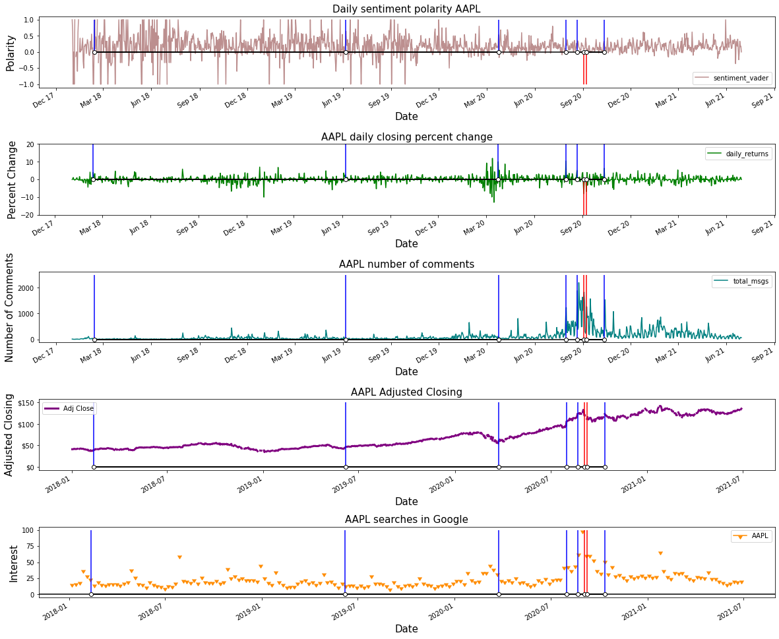
AAPL Milestones
Color | Milestone
Blue | Positive Returns
Red | Negative Returns
Notes:
Apple’s trends didn’t see as stark of a change in 2020 as Tesla did, but there is an increase in comments and a slighter neutralization in polarity, though the comments remain relatively positive. You can see there are much fewer major milestones for Apple. This is supported by the low number of returns that reached high percentages of change. Key takeaways are that Apple’s big events are correlated with the covid pandemic starting, the tech bubble bursting and the release of the new iphone which both occurred in the fall of 2020. Like Javier mentioned, the sentiment analysis for Apple does not appear to have very strong predicting power.

Slide 13
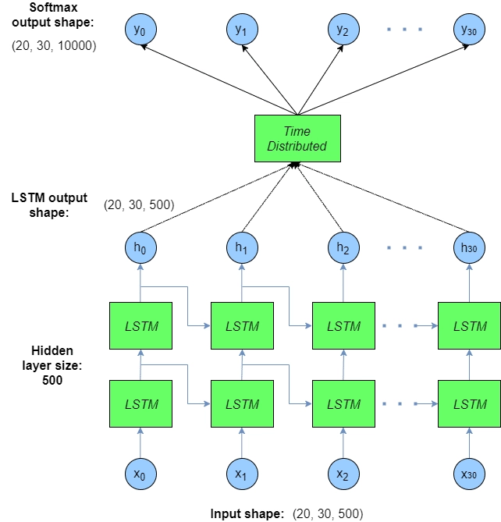
Long short term memory (LSTM)
a model that increases the memory of recurrent neural networks
Recurrent neural networks hold short term memory in that they allow earlier determining information to be employed in the current neural networks
Notes:
One of the main issues with RNN is the vanishing gradient problem, and it emerges due to the repeated use of the same parameters, in RNN blocks, at each step. We must try to use different parameters to overcome this problem at each time step.
http://alexlenail.me/NN-SVG/LeNet.html

Slide 14
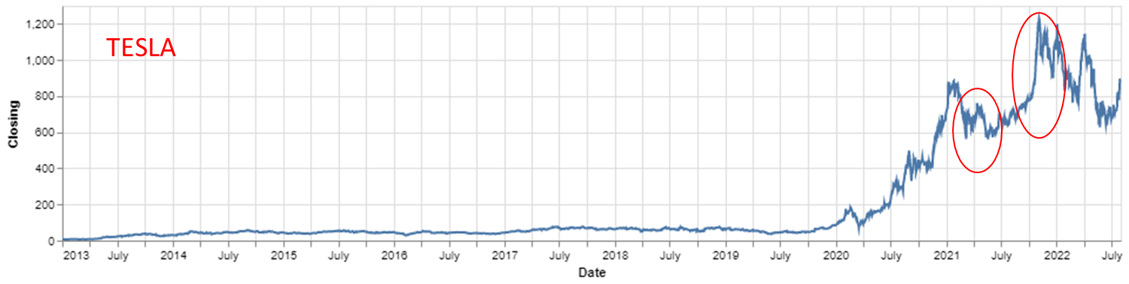
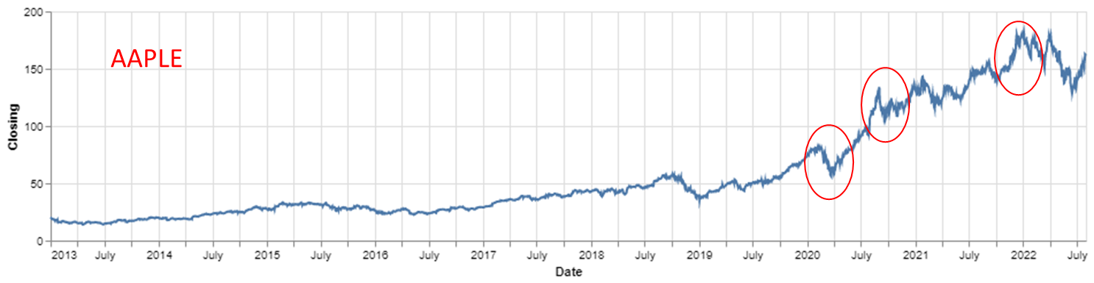
Initial Findings
What does the data look like?
Trends
Linking with Reddit Data
Increased Sales
Good Profits
Stock Splits
Starting off small: Looking at predicted stock price and the actual stock price during time of COVID-19

Slide 15
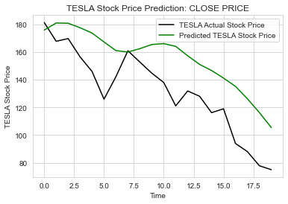
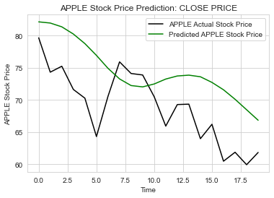
Predicting 20 Days
Training Data: January 1, 2014 - February 20,2020
Test Data: February 21, 2020 - March 30, 2020
Creating the LSTM Model
from keras.models import Sequential
from keras.layers import LSTM
from keras.layers import Dropout
from keras.layers import Dense
0.2 Dropout layer, add the Dense layer
Adam optimizer and set the loss as the mean_squared_error.
fit the model to run for 50 epochs with a batch size of 32

Slide 16
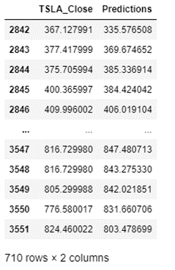
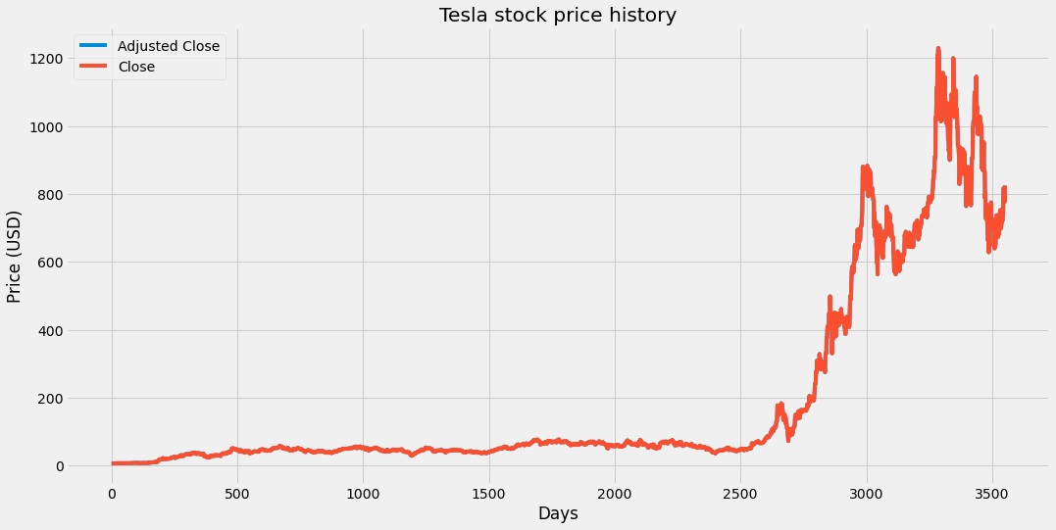
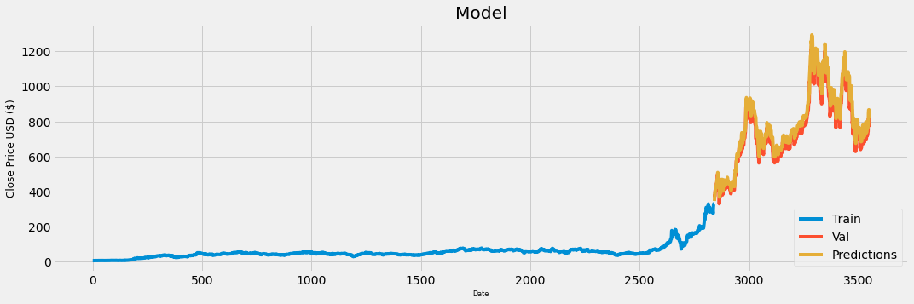
TSLA Closing Predictions
60 timesteps
Notes:
-Exploring the Dataset
-Data Pre Processing
-Splitting the Data for Training
-Implementing LSTM model

Slide 17
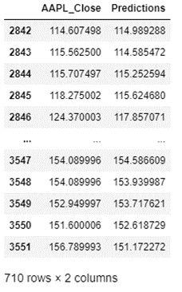
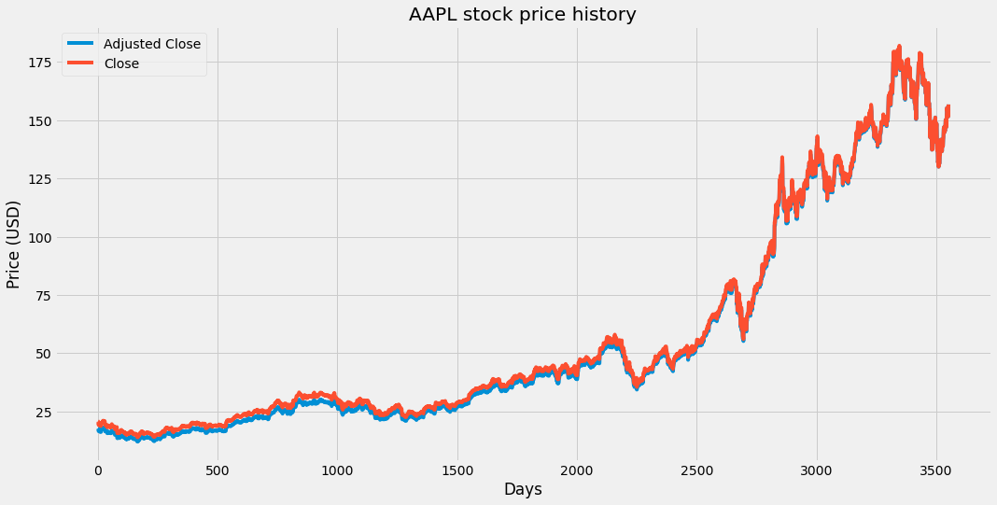
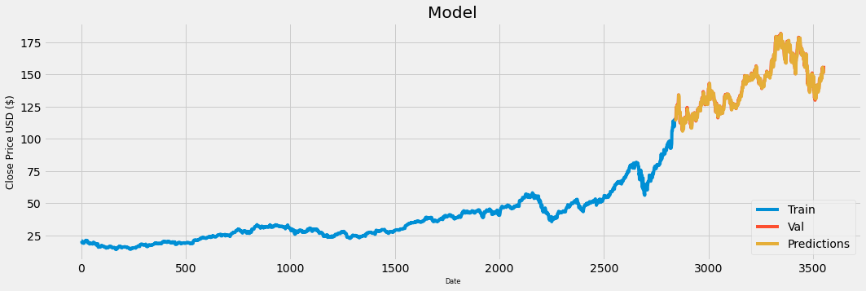
AAPL Closing Predictions
60 timesteps
Notes:
-Exploring the Dataset
-Data Pre Processing
-Splitting the Data for Training
-Implementing LSTM model

Slide 18



Wow, that is amazingly good!
Our LSTM neural network seems to do a wonderful job, it even predicts the huge 'COVID' drop seen around March 2020.
But…Where are we going wrong…?
The predicted price is trailing the true price by 1 time-step. The model is just predicting a value close to the previous price it sees, as this is the best prediction for the next price.

Slide 19
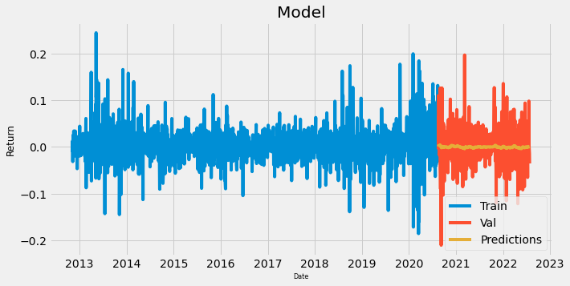
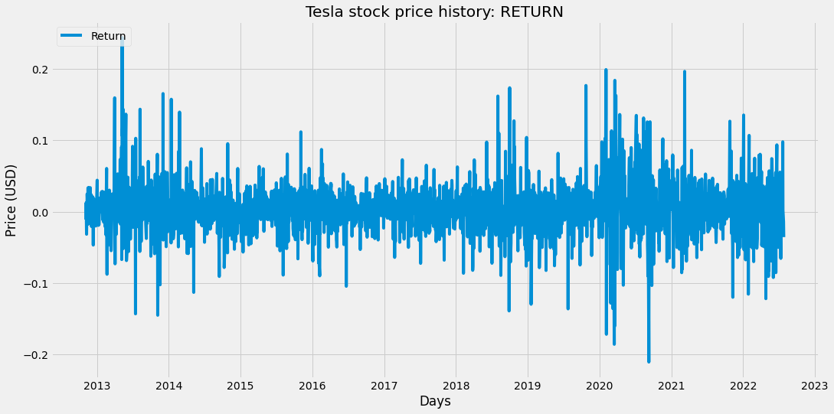
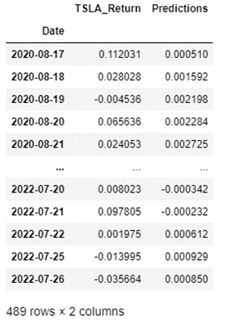
Improving the Model - RETURN
A return is defined as the change in price of stocks over time, which may be represented in terms of price change or percentage change.
positive return represents a profit
negative return marks a loss

Slide 20
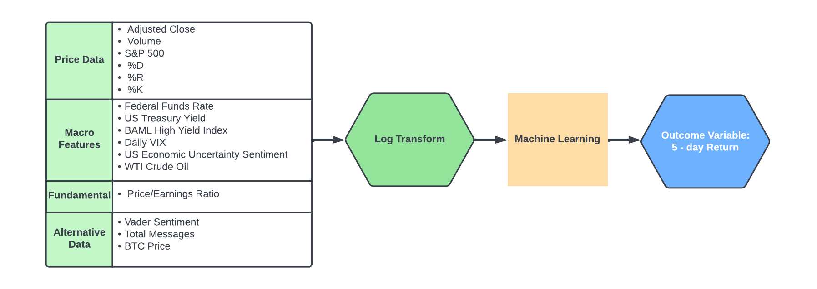
Updated Features, Labels, Modelling:
dominic
Baseline: 5-day TSLA return is the same as the previous 5-day return (MSE: 0.0347)
Notes:
Thanks Ria, To reflect our pivot to TSLA and AAPL, we’ve changed our dataset since our baseline presentation. As it relates to price data, we are using the 5 day return of our Adjusted Close as our outcome variable while using S&P500, and a number of stochastic technical indicators. We can basically think of these %D, %R, %K as different measures of how “overbought” or “oversold” stocks are based off moving averages.
For our macroeconomic features, we are focused on features that were most cited in our literature review. These include the Fed Funds rate, treasury yields, indexes measuring the health of debt markets, volatility, survey measures of economic uncertainty, and oil prices.
We’ve dropped most of our fundamental features to focus on Price / Earnings. In hindsight, P/E was not the best feature to use for a company like TSLA which was unprofitable for the majority of its history and therefore negative earnings
We also included reddit data which provides us Vader Sentiment and total messages. We also included bitcoin as a predictor variable as we’ve found that tsla and bitcoins prices are correlated..
From there we did a log transformation on our features and fed that into a variety of models. These trained models are then outputting a 5 day return of the TSLA stock. Our baseline to beat is assume the same 5 day return as previous 5-day return.

Slide 21
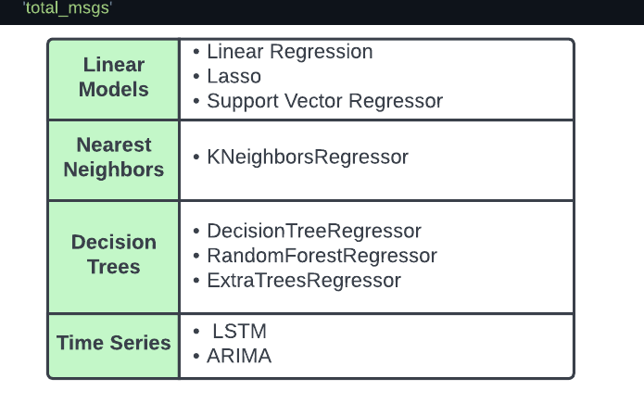
Models
Training Period: 11/2012 - 01/2021
Test Period: 01/2021 - 06/2021
Notes:
Here we’ve got a list of models that we wanted to evaluate. Many of these models are mentioned in the literature review.
Go through:
OLS LR, LASSO which is simply regression that penalizes additional features, SVR, Knearest neightbors, CART (DT),, Random forest, extra tree randomly chooses the split point for the nodes and does not calculate the optimal split.
ARIMA - Auto regressive integrated moving average. (ARIMA) models predict future values based on past events. ARIMA makes use of lagged moving averages to smooth time series data.
The last thing I wanted to point out was that we have a large train set relative to test. Because we have 10 yrs of price, fundamental, and macro data but only 2.5 yrs of sentiment data from 2018 to 2021, we needed our models to have enough training data to learn the sentiment features.

Slide 22
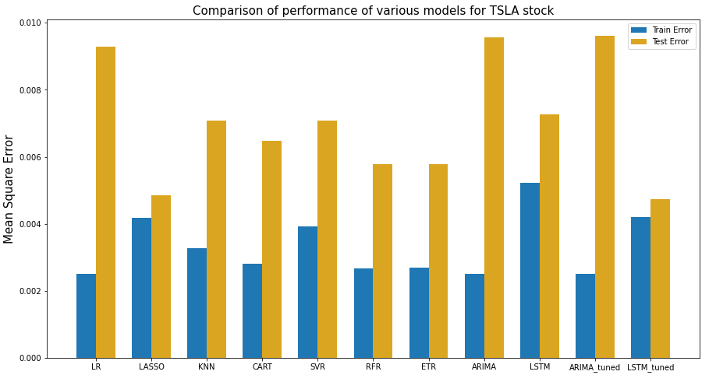
Model Tuning and Results
dominic
dominic
Notes:
We decided to fit and evaluate the linear and decision models using the SKlearn library.We used k-fold validation, as sequence of values in time are not considered in those models. For those models, we did not tune any of ther hyperparamters with the exception of the tree models. Where we limited the max_depth to 5 to avoid gross overfitting.
For the ARIMA model we utilized stats model library. We decided to tune the ARIMA and LSTM models because we were primarily interested in time series aspect.
We utilized loops to tune both the ARIMA and LSTM models. With the LSTM model in particular, we tried 144 different combinations, cycling through different number of layers , number of nodes per layer, the optimizer, as well as the drop out rate.
densenumber=4, denselayersize=64, optimizer='rmsprop', dropoutrate=0.4
We can see that the tuned LSTM model does enjoy some improvements in model error.
Cross-validation is a resampling procedure used to evaluate machine learning models on a limited data sample.

Slide 23
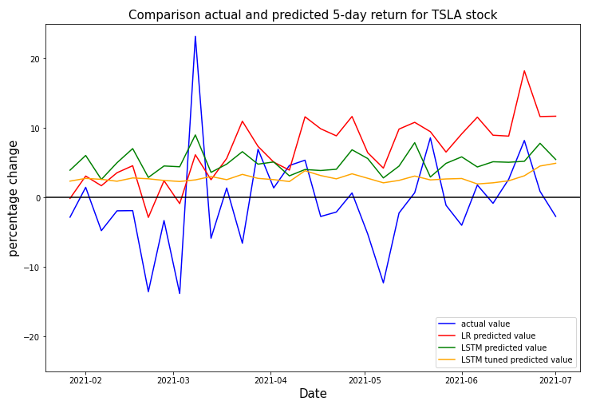
Results
dominic
dominic
Our baseline of the 5-day return is the same as the previous 5-day return (MSE: 0.0347)
All the models beat the baseline
LSTM-tuned model is the best model for TSLA
Notes:
We plotted the actual 5 day return in blue to compare with our predicted values.
So we don’t think that we’ll be making millions with our models but this was a fun forway into stock prices. And this is something we’d like to continue to explore further. Let us know if you have any questions!

Slide 24

Questions?
Notes:
Transition after “traditional, numeric data and alt,text data
”If we had more time, we would more features, we would (each person says something important they learned and wished they had more time to explore.

Slide 25
Backup Slides

Slide 26
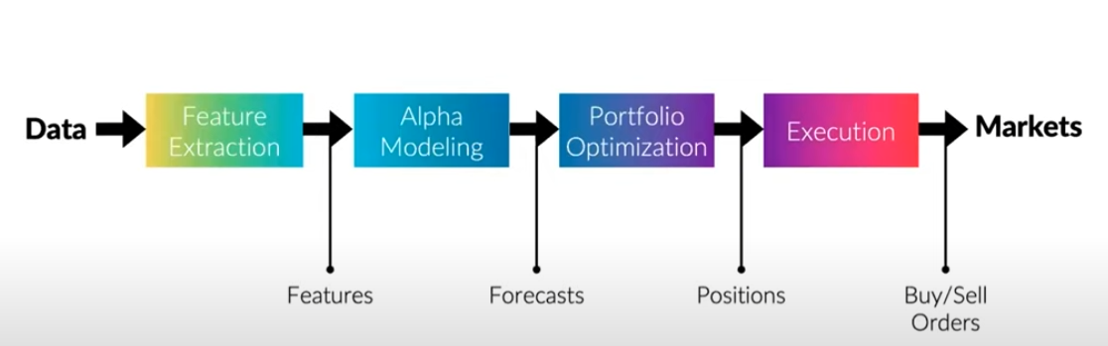

Slide 27
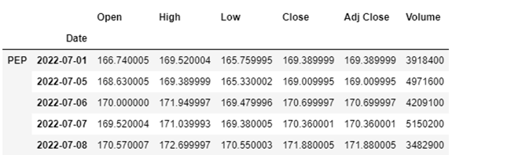
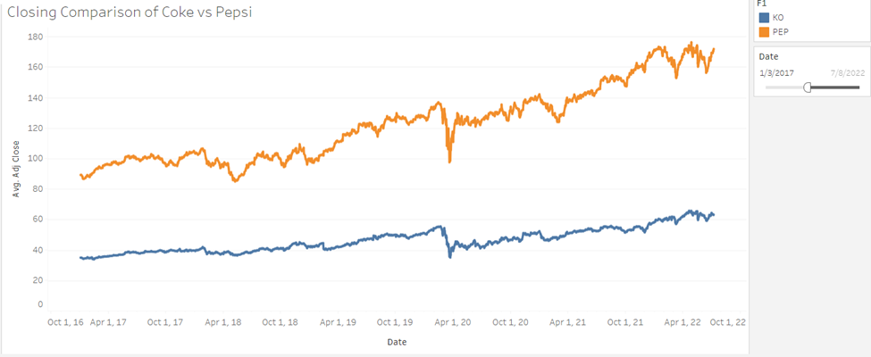
Yahoo Finance API
Ria to Present
Importing data for the stocks we wanted to look at
Using adjusted closing price
Includes dividends, stock splits, and new stock offerings
What can we learn from this?
“Dip” in prices
COVID
SuperBowl
Special Media Coverage
Noticing trends
Notes:
Transition after “Additionally, When selecting a security for investmen”

Slide 28
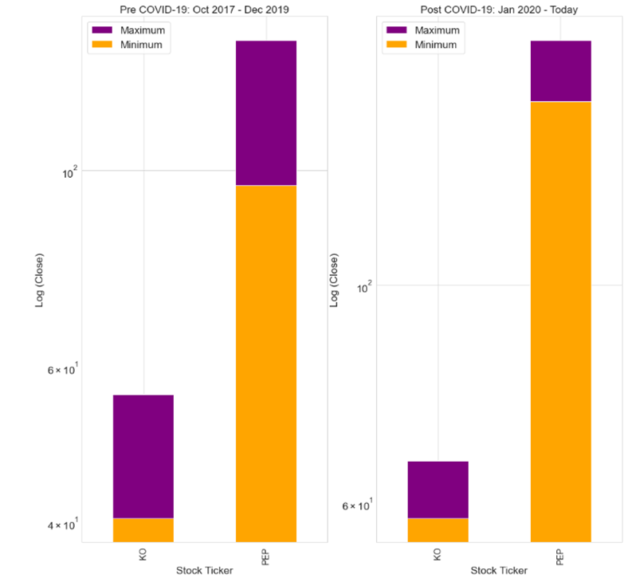
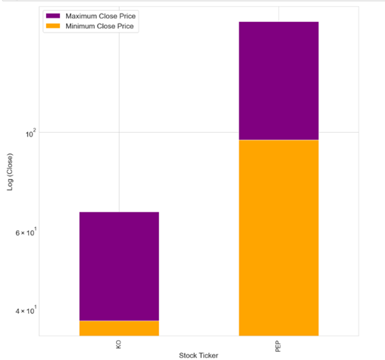
Reliable Stocks vs Volatile Stocks
**Note: We use a log scale for close price to normalize the values to a uniform scale.
Ria to Present

Slide 29
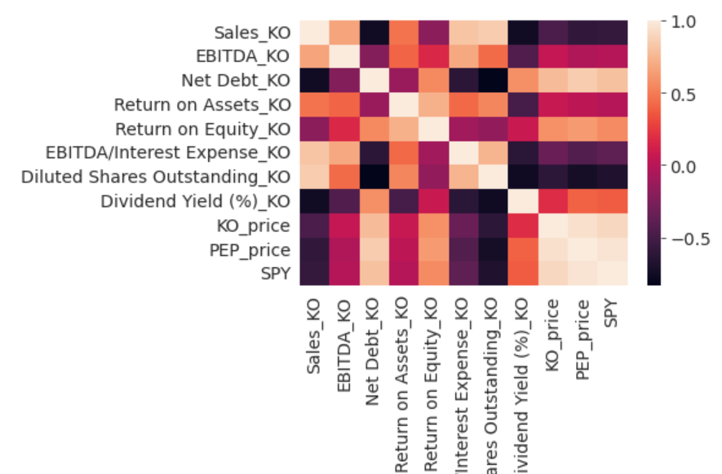
3. Fundamental Data
Dom to Present
Notes:
With Fundamental Data, we are looking at how the business itself is doing. Using publicly available information from quarterly financials, we pulled down 10 years of earnings, cash flows, and balance sheet data from Factset to get a can get a sense of how the company performed historically.
That being said, Macroeconomic and Fundamental Data are inherently backward looking. Therefore we wanted to bolster our dataset with alternative data like sentiment analysis to get a sense of what investors are thinking about where the stock price will go.

Slide 30
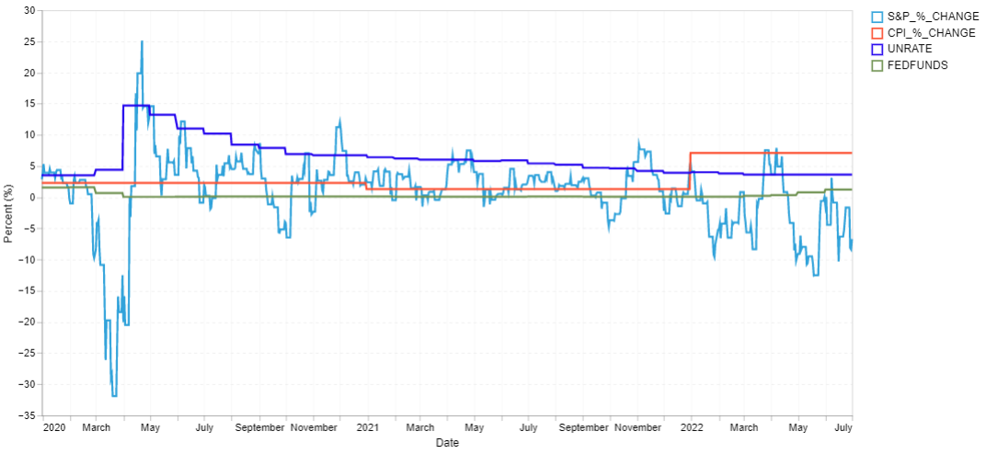
2. Macroeconomic Data
Dom to Present
Fed Signals Funds
Rate Increases
COVID-19
Source: Federal Reserve Economic Data (FRED API)
Notes:
Macroeconomic data are statistics that reflect the performance of the economy. For macroeconomic features, we took Federal Reserve Economic Data and limited ourselves to 10 features covering GDP, unemployment, Inflation, Fed Fund Rate, and Consumer Sentiment. We think that these features help to tell the story of what’s been happening in the stock market in the last several months.
If we rewind back to March 2020 when the COVID pandemic first hit, the U.S saw a dramatic increase in unemployment with the S&P500 taking a large drop.
And so we think that inflation and recession fears are going to continue to drive market movement.

Slide 31
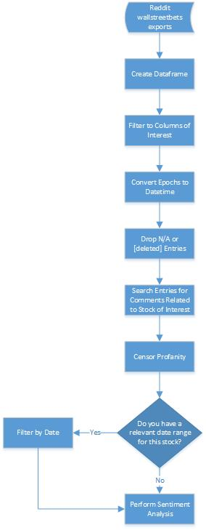
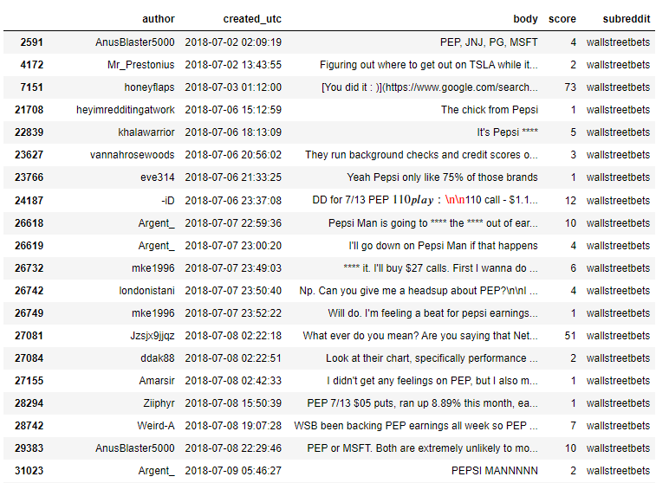
Reddit Parser
Tori to Present
Notes:
After acquiring the Reddit data for wallstreetbets, we needed to move the data into a dataframe and clean it. Here you can see an example of the July 2018 data that has been filtered for Pepsi. In order to create this dataframe, we removed any columns that weren’t of interest, dropped any deleted comments, converted epochs to datetime, filtered based on key terms, and, of course, attempted to censor any profanity. If there is a date range we have in mind, we’re able to use that as a filter as well before moving on to sentiment analysis.

Slide 32
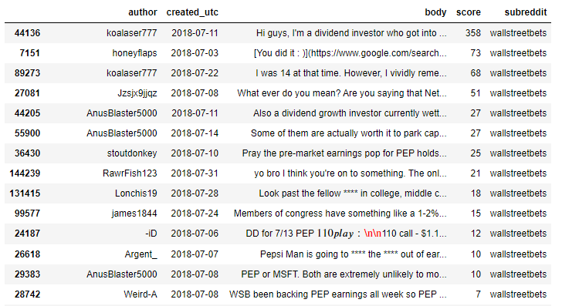
Initial Reddit EDA
Author | # of Posts by Author
A***Blaster5000 | 7
koalaser777 | 5
stoutdonkey | 3
Argent_ | 3
wh3atthinz | 2
londonistani | 2
Mr_Prestonius | 2
Ziiphyr | 2
darkflash26 | 2
mke1996 | 2
rnjbond | 2
Date | # of Pepsi related posts in wallstreetbets
2018-07-02 | 2
2018-07-03 | 1
2018-07-06 | 5
2018-07-07 | 5
2018-07-08 | 6
2018-07-09 | 6
2018-07-10 | 7
2018-07-11 | 2
2018-07-12 | 5
2018-07-14 | 2
2018-07-16 | 2
2018-07-18 | 1
2018-07-22 | 1
2018-07-23 | 1
2018-07-24 | 3
2018-07-25 | 1
2018-07-26 | 1
2018-07-27 | 1
2018-07-28 | 6
2018-07-30 | 1
2018-07-31 | 1
Tori to Present
Reddit data can be used to identify:
Reputable or frequent users
Dates of interest to be checked against stock data
Sentiment towards stock
Notes:
Once we had a clean dataframe, we began to identify key insight we can pull from the data. We are able to determine who are reputable and frequent users based on how often they post and what score they received. We are able to find potential dates of interest when there are a higher number of comments made about our stock of interest. The most important insight is the general sentiment analysis of the Reddit comments, which is included in our next steps. From our initial look at Coca Cola and Pepsi data, we have learned to consider potential alternate meanings of key terms associated with the stock we choose. For example, comments with the phrase “coke” or “KO” were not always related to Coca Cola’s stock. This will ultimately affect the relevancy of our sentiment analysis.

Slide 33


Reddit Dataset
Javier to Present
Reddit is a social news aggregation and discussion site
As of March 2022 it is the 9th most visited site in the world
Posts are organized by “subreddits”
We used “WallStreetBets” as the source for sentiment regarding the stock market
participants discuss stock and trade options
As of July 2022, it has 12.3 M members.
“Like 4chan found a Bloomberg Terminal”
Notes:
Objective is to conduct sentiment analyses to produce features to enrich our machine learning model
Literature search indicated most studies on sentiment in social media and stock market focus on twitter. We selected reddit
We found the most popular investing subreddit
Notable for its language and investment strategies
Played a role in the GameStop squeeze last year.
Very popular. Traffic increased from 50k comments per month to 300k comments per month from 2018 to 2019.

Slide 34
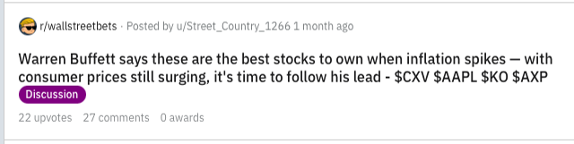
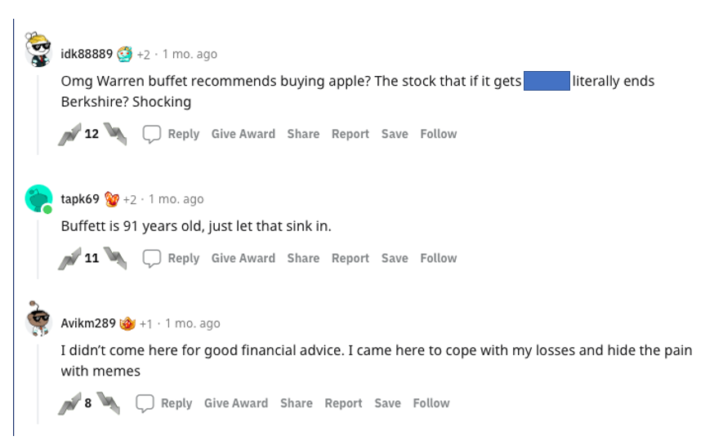
r/wallstreetbets
Example submission:
Timeline: 2018-2021
Source: https://files.pushshift.io/reddit/comments/
Compressed size: 900 GB split in monthly file dumps
JSON files extracted with only the comments in the Wallstreetbets subreddit
38 million comments
Example comment:
Notes:
Source data maintained by reddit volunteers
We downloaded 4 years of data.
We created workflow to process the file and extrac the relevant information for our study
Example of how the subreddit sumisison and comments are captured.

Slide 35
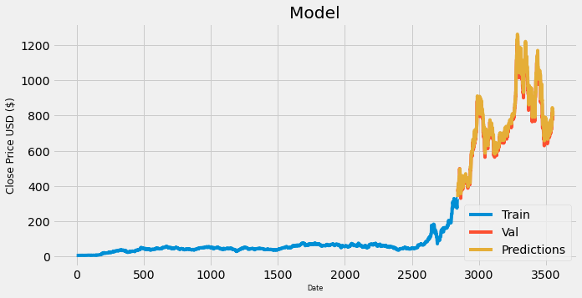
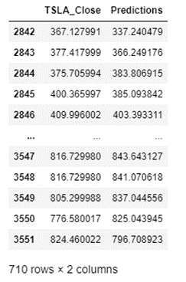
TSLA Closing Predictions
180 timesteps
Notes:
-Exploring the Dataset
-Data Pre Processing
-Splitting the Data for Training
-Implementing LSTM model

Slide 36
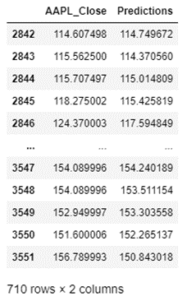

AAPL Closing Predictions
180 timesteps
Notes:
-Exploring the Dataset
-Data Pre Processing
-Splitting the Data for Training
-Implementing LSTM model

Slide 37
Tesla Learnings
Apple Learnings
60 Timestep:
-Number of rows and columns: (710, 60, 1)
-RSME: 38.06332196602403
-MAPE: 4.0180439363100025
180 Timestep:
-Number of rows and columns: (710, 180, 1)
-RSME: 32.536100525651094
-MAPE: 3.339758842815947
60 Timestep:
-Number of rows and columns: (710, 60, 1)
-RSME: 2.3567257014573357
-MAPE: 1.142171050494351
180 Timestep:
-Number of rows and columns: (710, 180, 1)
-RSME: 2.396970097507898
-MAPE: 1.186364020877183

